Slide 1
Hanzhi Wang
Revisiting Local PageRank Estimation on Undirected Graphs: Simple and Optimal
Renmin University of China
August 28, 2024
Notes:
Hello everyone. I am Hanzhi Wang from Renmin University of China. It’s my pleasure to present my single-authored paper, "Revisiting Local PageRank Computation on Undirected Graphs: Simple and Optimal."

Slide 2
Outline
1
Background
2
Problems and Contributions
3
Baselines and Our Techniques
4
Experiments
5
Future Work
Notes:
This talk will be divided into five parts.

Slide 3
Outline
Random-Walk Probability Estimation
1
Background
2
Problems and Contributions
3
Baselines and Our Techniques
4
Experiments
5
Future Work
Notes:
First, I would like to introduce some background knowledge before presenting my paper. Briefly speaking, this work focuses on random-walk probability estimation on large graphs.

Slide 4
Random Walks on Graphs
10
9
12
2
1
8
3
11
$$1/3$$
$$1/3$$
4
$$1/4$$
$$1/3$$
$$1/4$$
For a walker currently at node $u$:
Randomly selects a neighbor $v$ of $u$
Moving from $u$ to $v$
6
5
$$1/4$$
$$1/4$$
7
Notes:
A random walk on a graph is a Markovian /mɑ:‘kəuviən/ process. (click!) Intuitively, we can imagine that there is a walker on the given graph, continually moving from one node to one of its out-neighbors. For example, if the walker is currently at node 4 (click!), then in the next step, it will select a neighbor of node 4 uniformly at random (click!), move from node 4 to this selected neighbor, and repeat this process. This is called a random walk process on graphs. The goal of random-walk probability estimation is to estimate the probability of a random walk moving from one node to another node.

Slide 5
Random Walks on Graphs
Algorithmic Building Block in Modern Network Analysis
Notes:
Random walks on graphs are algorithmic building blocks in graph theory and modern network analysis. The computation of random-walk probabilities has been a versatile tool with multifaceted applications. A typical example is the famous graph learning method DeepWalk, which just received the Test-of-Time award of KDD this year. The high level idea of the DeepWalk method is to generate multiple random walks on graphs, and leverage random-walk probabilities to learn node embeddings. The success of DeepWalk further demonstrate the importance and wide applications of random walks and random-walk probability estimation on graphs.

Slide 6
$α$-Discounted Random Walks ($α$-Walks)
10
9
12
2
1
8
3
11
$$α$$
4
$$1−α$$
Damping Factor $α∈(0,1)$
6
5
In each step:
w.p. $α$, terminates;
w.p. $1−α$, moves to a random out-neighbor
$$1−α$$
7
Notes:
In particular, in this paper, we focus on a special type of random walk called alpha-walks, which incorporate a damping factor, alpha, to define the walking process. In an alpha-walk, (click!) the walker has a probability of alpha to terminate at each step. Thanks to the presence of alpha, the length of an alpha-walk won’t be too long, and the walking probabilities quickly converge. These desirable properties make alpha-walks one of the most significant types of random walks.

Slide 7
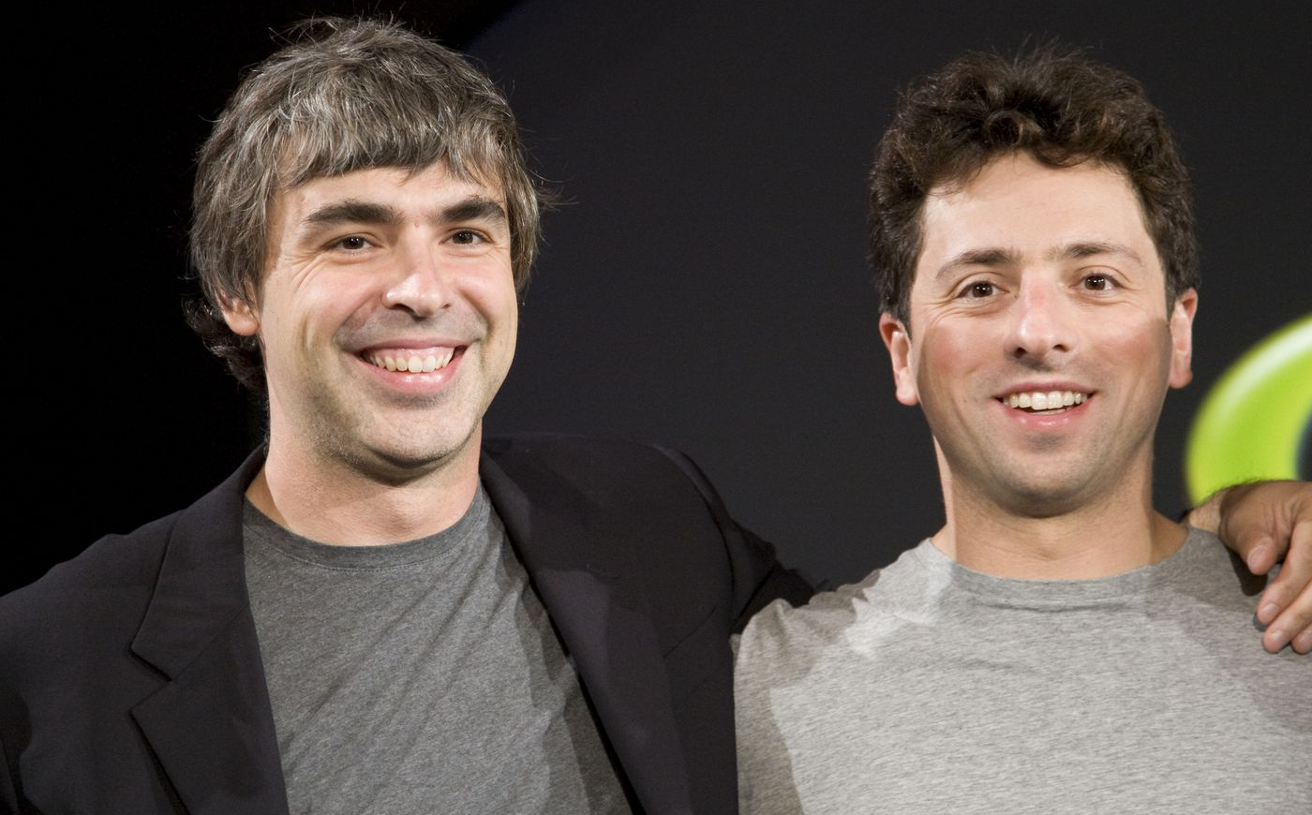
$α$-Walks and PageRank
PageRank: Top 10 Data Mining Problems
Proposed by Google for Ranking Web Pages in 1998
Co-founders of Google:
Larry Page, Sergey Brin
Graph Centrality Estimation [FOCS’18, SICOMP’23]
Local Graph Partitioning [FOCS’ 06]
Graph Sparsification [STOC’ 04]
Property Testing [Kale and Seshadhri, ’11]
Graph Neural Networks [ICLR’ 19, NeurIPS’ 20, ICLR’ 21]
Notes:
Another reason alpha-walks are very famous is that Google uses alpha-walks to define PageRank. PageRank is a very famous node centrality metric, which was initially proposed by the cofounders of Google to rank web pages on the Internet. The problem of PageRank computation has been recognized as one of the top 10 data mining problems in the last decade, and has been widely used in various applications such as graph partitioning, graph sparsification, property testing, and graph neural networks.

Slide 8
PageRank
Given a
Target Node
$π(t)$
$$t$$
Node $t$’s PageRank Score
Uniformly Sampled Source Node
$π\left(t\right)=$ Pr{$α$-walk from a randomly selected source node terminates at $t$}
Notes:
It was proven that computing a webpage, or any other entity’s PageRank score in a network is equivalent to computing random-walk probabilities on graphs. Specifically, for any node t in the graph, (click!) the PageRank score of node t is equal to the probability that an alpha-walk generated from a random source node terminates at node t. Therefore, the widespread applications of PageRank inherently highlight the importance of efficiently computing random-walk probabilities on large graphs.

Slide 9
Outline
1
Background
2
Problems and Contributions
3
Baselines and Our Techniques
4
Experiments
5
Future Work
Notes:
Given these importance and various applications, in this paper, we focus on a fundamental problem in random-walk probability estiamtion, known as single-node PageRank estimation.

Slide 10
Problem Formulation
Single-Node PageRank Estimation on Undirected Graphs
Given a
Target Node
Estimating $π(t)$
$$t$$
goal:
given a target node $t$, estimating $π(t)$ within constant relative error w.h.p.
Uniformly Sampled Source Node
$$\operatorname{Pr}\left\{\left|\hat{π}\left(t\right)−π(t)\right|>\frac{1}{2}∙π\left(t\right)\right\}≤\frac{1}{3}$$
Notes:
Specifically, given an arbitrary target node t in the underlying graph, we aim to estimate the PageRank score of node t while ensuring a constant relative error and a constant success probability. We particularly focus on undirected graphs.

Slide 11
Our Contributions
Optimal Single-Node PageRank Estimation on Undirected Graphs
InternetMath 2005
WAW 2007
WAW 2015
VLDB 2023
KDD 2024 (Ours)
upper bound
upper bound
$O\left(nd_{t}\right)$
upper bound
$O\left(n\right)$
$O\left(n^{\frac{1}{2}}d_{t}^{1/2}\right)$
upper bound
$O\left(\log{n}∙min⁡\left\{d_{t}, m^{\frac{1}{2}}\right\}\right)$
upper bound
$O\left(\frac{1}{d_{min}}∙min⁡\left\{d_{t}, m^{\frac{1}{2}}\right\}\right)$
$Ω\left(\frac{1}{d_{min}}∙min⁡\left\{d_{t}, m^{\frac{1}{2}}\right\}\right)$
lower bound
$Ω\left(1\right)$
$Ω\left(1\right)$
$Ω\left(1\right)$
$Ω\left(1\right)$
lower bound
lower bound
lower bound
lower bound
$n,m$: number of nodes/edges in the graph
${d_{t}}_{ }$: degree of $t$
${d_{min}}_{ }$: minimum degree of the graph
Notes:
We consider the worst-case computational complexity for this problem under the standard RAM model, and established matching upper and lower bounds in this paper, closing the longstanding theoretical gap for this problem. To take a closer look at our results, our upper bound is 1 over dmin times the minimum of dt and the square root of m, where dmin denotes the minimum degree of the graph, dt denotes the degree of the given target node t, and m denotes the number of edges in the graph. This result improves the previous best upper bound, established in a VLDB 2023 paper, by a factor of logn over dmin. More importmantly, we also improved the lower bound for this problem under the arc-centric graph access model, from a trivial result Omega(1) to the matching result compared to our upper bound, which demonstrate the optimality of our results.

Slide 12
Our Contributions
Monte Carlo Sampling is All You Need!
Notes:
The most interesting is, we achieve our optimal results without using any complicated techniques. We show that the simple monte-carlo sampling is sufficient to achieve the optimality. To apply a phrase that is frequently used these years, we would like to say that Monte-Carlo sampling is all you need, for random-walk probability estimation on undirected graphs.

Slide 13
Our Contributions
Monte Carlo
Sampling
Deterministic Push
Monte Carlo
+ Push
Randomized
Push
Monte Carlo
Sampling
InternetMath 2005
WAW 2007
WAW 2015
VLDB 2023
KDD 2024 (Ours)
upper bound
upper bound
$O\left(nd_{t}\right)$
upper bound
$O\left(n\right)$
$O\left(n^{\frac{1}{2}}d_{t}^{1/2}\right)$
upper bound
$O\left(\log{n}∙min⁡\left\{d_{t}, m^{\frac{1}{2}}\right\}\right)$
upper bound
$O\left(\frac{1}{d_{min}}∙min⁡\left\{d_{t}, m^{\frac{1}{2}}\right\}\right)$
$Ω\left(\frac{1}{d_{min}}∙min⁡\left\{d_{t}, m^{\frac{1}{2}}\right\}\right)$
lower bound
$Ω\left(1\right)$
$Ω\left(1\right)$
$Ω\left(1\right)$
$Ω\left(1\right)$
lower bound
lower bound
lower bound
lower bound
$n,m$: number of nodes/edges in the graph
${d_{t}}_{ }$: degree of $t$
${d_{min}}_{ }$: minimum degree of the graph
Notes:
Remarkably, monte-carlo sampling has been adopted to solve this problem very early, in 2005, but at that time, the complexity bound is not optimal. Afterwards, several techniques were proposed for solving this problem, but finally, after twenty years later, we show that the basic monte-carlo sampling technique suffices to achieve the optimality if we use it in a smart way.

Slide 14
Outline
1
Background
2
Problems and Contributions
3
Baselines and Our Techniques
4
Experiments
5
Future Work
Notes:
To see this more clearly,

Slide 15
Monte-Carlo Sampling Method [InternetMath ’05]
$π\left(t\right)=$ Pr{$α$-walk terminates at $t$}
# of $α$-walks terminating at $t$
Given a
Target Node
$≈$
# of $α$-walks generated in total
Uniformly Sampled Source Node
$$t$$
$Ω\left(n\right)$ time to estimate $π\left(t\right)≥\frac{1}{n}$
Uniformly Sampled Source Node
Uniformly Sampled Source Node
Notes:
Let’s first see how the basic monte-carlo sampling method works. Given a target node t, we aim to estimate the pagerank score of node t. Recall that the PageRank score of node t equals the probability that an alpha-walk generated from a randomly sampled source node terminates at node t. So, based on this probabilistic interpretation, (click!) the Monte Carlo method estimates the PageRank score of node t by generating multiple alpha-walks in the graph. Each alpha walk is generated from a uniformly random source node. Then the Monte Carlo method calculates the proportion of alpha-walks that terminate at node t relative to the total number of alpha-walks generated in the graph, and uses this propagation as the final estimate for \pi(t). This is the Monte Carlo sampling method. It's not hard to see that the derived estimate is an unbiased estimate for \pi(t), and the algorithm's structure is very straightforward. However, a challenge for the Monte Carlo method is that it requires significant time costs when estimating small probabilities. For example, if we are given a target node t whose PageRank score is very small, such as 1/n, then the Monte Carlo sampling requires \Omega(n) time to estimate \pi(t).

Slide 16
Monte-Carlo Sampling Method [InternetMath ’05]
$Ω(n)$ time to touch $t$ at least once
$$u$$
$$t$$
$n$ nodes
$$…$$
$$…$$
Notes:
To be more specific, let's consider this toy graph. (click!) If we aim to estimate the PageRank score of the given target node t in this toy graph, we must generate more than n alpha-walks in the graph to ensure that at least one alpha-walk reaches node t at least one. In other words, there is an \Omega(n) lower bound for the time it takes an alpha-walk generated from a random source node to reach node t in the worst-case scenario.

Slide 17
Our BackMC Algorithm
$$O\left(\frac{1}{d_{min}}∙min\left(d_{t},\sqrt{m}\right)\right)$$
$O(n)$
Optimal !
Basic Monte Carlo Sampling
Ours, Monte Carlo Sampling but from the target node $t$
Symmetry of Random-Walk Prob. on Undirected Graphs:
$π\left(u,t\right)∙d_{u}=π\left(t,u\right)∙d_{t}$
$$u$$
$$t$$
$n$ nodes
$$…$$
$$…$$
$n,m$: number of nodes/edges in the graph
${d_{t}}_{ }$: degree of $t$
${d_{min}}_{ }$: minimum degree of the graph
Notes:
So how should we break this \Omega(n) lower bound? I would like to mention that we currently consider undirected graphs, so the edge has no direction. Random-walk probabilities on undirected graphs has a very nice property, that is, the random-walk probability from any nodes u to t, and be converted to the random-walk probability from node t to u, just by multiplying some correction factor. Based on this symmetry, we no longer need to generate random walks from a uniform random source node. Instead, we can first generate alpha-walks from the given target node t to estimate the probabilities that random walks from t terminate at other nodes. Then, we use the symmetry of random-walk probabilities to revise the previously obtained random-walk probability approximations. By this means, we can still derive an unbiased estimate while using siginificantly less time than the original monte-carlo sampling method of generating random walks from a random source node. This is the whole picture of our algorithm, and we prove that the time complexity of our algorithm is optimal by establishing a matching lower bound.

Slide 18
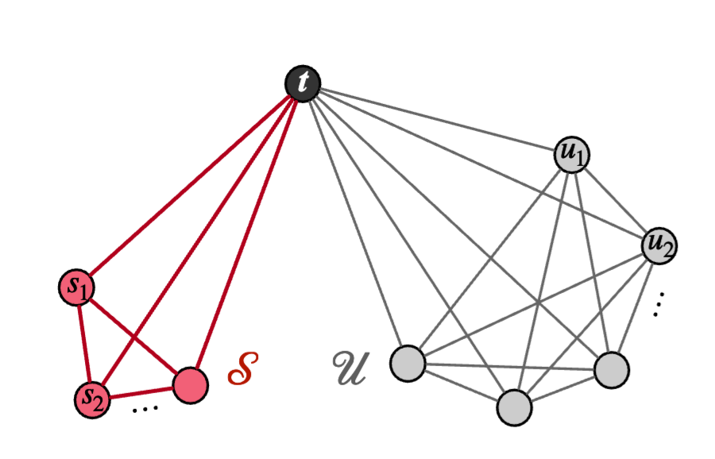
Lower Bound: $Ω\left(\frac{1}{d_{min}}∙min\left(d_{t},\sqrt{m}\right)\right)$
$d_{s}=d_{min}$
#s = $d_{min}$
$d_{u}=\sqrt{m}$
#u = $\sqrt{m}$
Notes:
We prove the lower bound by constructing a hard instance and proving that we must use at least this amount of time to accurately estimate the pagerank score of node t in this graph. There are two components of this hard instance, the red part contains dmin nodes, each node’s degree is also dmin. The grey part contains sqruare root of m nodes, with the degree of each node as the square root of m. We prove that nodes in the two parts contributes equally to node t’s pagerank, thus, any algorithm to accurately estimate the pagerank score of node t must at least identify the existance of nodes in the red part, but this requires at least this amount of time, leading to our lower bound.

Slide 19
Our BackMC Algorithm
Lay a theoretical foundation for the efficacy of random walk simulations in undirected graphs
Notes:
We would like to mention that many previous works focusing on undirected graphs, such as those on graph embedding and graph neural networks, have extensively utilized the monte-carlo sampling technique to estimate random-walk probabilities on graphs. These methods are empirically shown very efficient. For example, the DeepWalk method, which applies random-walk simulation on undirected graphs to compute node embeddings, has been widely recognized as efficient and useful, even winning the Test of Time award this year. However, from a theoretical perspective, previously, there was a gap in understanding the computational complexity of random-walk simulations. We hope that our optimal bounds and analysis can help establish a theoretical foundation for the efficiency of random-walk simulations on undirected graphs.

Slide 20
Outline
1
Background
2
Problems and Contributions
3
Baselines and Our Techniques
4
Experiments
5
Experiments
Notes:
Finally, to see the empirical performance of our method, our method is definitely efficient since our algorithm structure is simple and our theoretical bound is optimal.

Slide 21
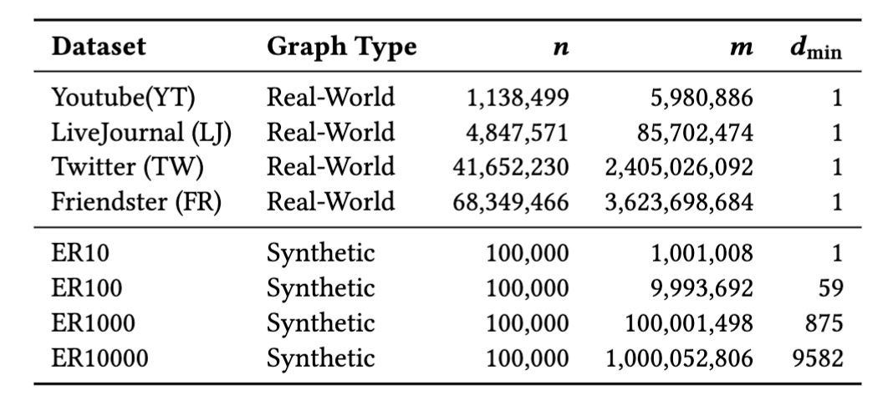
Experiments
Datasets
Notes:
We conduct experiments on four large real-world datasets and four synthetic graphs.

Slide 22
Experiments on Real-World Graphs
Relative Error
Query
Time
Notes:
On real-world graphs, we show that our method, indicated by the blue lines, costs the least query time while achieving the same level of approximation error.

Slide 23
Experiments on Synthetic Graphs
$$d_{min}=1$$
$$d_{min}=59$$
Relative Error
$$d_{min}=875$$
$$d_{min}=9582$$
Query
Time
Notes:
Simiarly, on synthetic graphs, our method consistently outperforms other baseline methods. It’s worth mentioning that the value of dmin, the minimum node degrees of the four synthetic graphs gradually increase. And we observe that the superority of our method increases as dmin increases,
The experimental results show that our setpush costs the minimum query time over all existing methods, no matter the target node t is uniformly sampled in the graph, or is sampled according to the node degree distribution.

Slide 24
Outline
1
Background
2
Problems and Contributions
3
Baselines and Our Techniques
4
Experiments
5
Future Work
Notes:
Finally, to conclude,

Slide 25
Conclusions and Future Work
We derive matching upper and lower bounds for single-node PageRank
estimation on undirected graphs.
Our analysis is simple and optimal.
Open problems:
extend our results to other queries / measures
non-constant $α$

Slide 26
Thanks! Q&A
Contact: hzwang.helen@gmail.com
Notes:
That’s all of my presentation, thank you very much. Any question?

